Slide 1
Continuing Professional Development for Teacher-Educators CPDC Introduction to ECCE & PES CPDC Development Team
In association with the National Commission for Colleges of Education, Abuja
May 2015

Slide 2
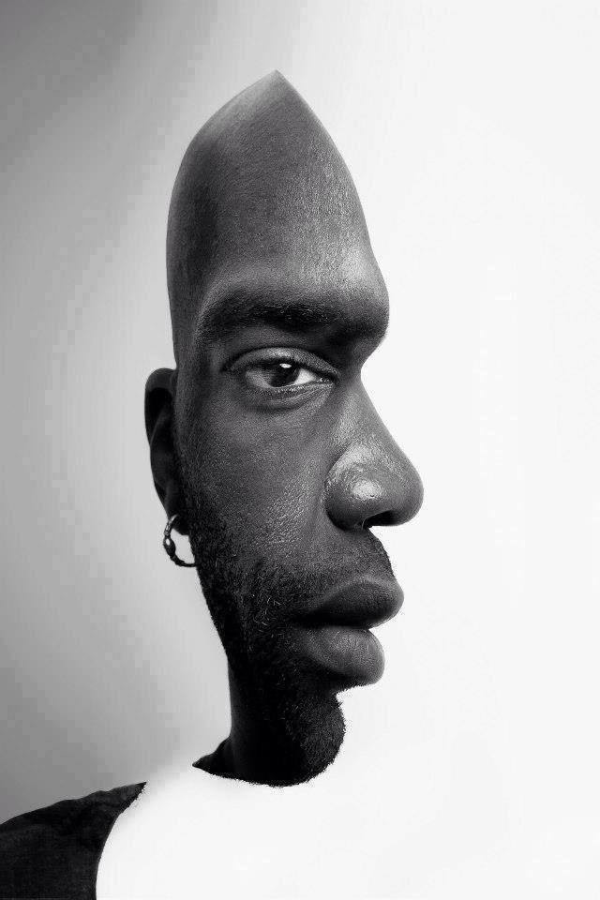
Warm up activity
Consider the following images. What do they suggest about how we should approach this session?

Slide 3
College teams
Team leader
Orientation
Induction
Core and elective module allocations
Portfolios and final assessment
Student feedback
Certification/graduation
Formative monitoring and evaluaton

Slide 4
ECCE/PE GROUP: Overview
Let’s know ourselves.
Let’s understand the module.
Let’s understand the assessment tasks.

Slide 5
Let’s know ourselves
Overview of CPDC TLM

Slide 6
Early Childhood Care Education (ECCE) and Primary Education (PE)
Let’s know ourselves
Break into pairs.
Each member of the pair should interview his/her colleague to find out:
His/her name
His/her subject(s)
His/her most meaningful teaching or learning experience.
When ready, each member of the pair introduces his/her partner to the rest of the group.

Slide 7
Overview of the module The module introduces ECCE & PE courses as an elective component of the NCCE-TDP Continuing Professional Development Programme for teacher educators. This module is divided into seven units to facilitate accomplishment, understanding and assessment of the programme. It starts with an introduction and a statement of objective followed by expected learning outcomes, methodology and appropriate instructional technology and learning resources.
Overview of the ECCE & PES

Slide 8
Warm-up
Brainstorm on the following:
Reflect on how you were taught in your Primary School days.
Compare that with how our students teach in the primary schools today.
Examine the differences.
Consider your school entry age with that of our children.
Explain the implications of both.
Discuss and explain the challenges which teacher-Educators would face in training ECCE and PES teachers.

Slide 9
LOOK AT THIS

Slide 10
AND THESE

Slide 11
Early Childhood Care Education & Primary Education
Rethinking
Identify other variables that can facilitate effective teaching and learning process in ECCE & PE classes.
Which types of learning resources can we use for successful teaching and learning in an ECCE/PE class?
Suggest ways of coping with over population in ECCE/PE classes experienced in public schools.

Slide 12
Purpose
The purpose of the ECCE/PE module :
Orientation programme on the new curriculum.
Refresher courses on new course content on ECCE/PE.
Integration of appropriate technologies and learning resources.
New pedagogies and skills for the operation of basic instructional aids.
More inclusive classroom practice to accommodate greater diversity.

Slide 13
Early Childhood Care Education & Primary Education
Content
1.Orientation to curriculum reform in ECCE & PED
2. Teaching in ECCE
3. Nigerian Languages in Primary Education.
4. Introduction of Ajami as Medium of Writing.
5. Creating and maintaining an appropriate learning environment.
6. Activity-based classrooms
5. Music and Dance.
All based on practical examples

Slide 14
ACTIVITY
State two (2) types of traditional dance performed in your community during rituals and festive ceremonies.
List and explain the materials used in production of traditional musical instruments in your community.
Plan, teach and reflect upon a lesson using the music and dance important in the development of culture in your community.

Slide 15
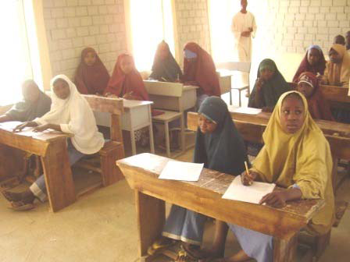
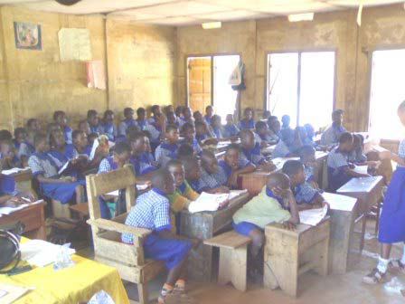
Traditional approach in teaching

Slide 16
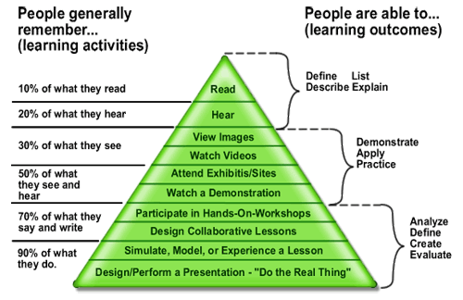
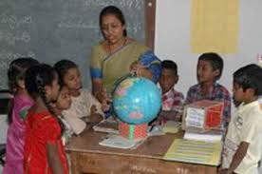
Cone of experience

Slide 17
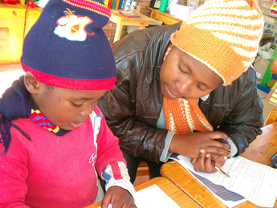
But does this apply to young children?
ttps://www.google.co.za/search?hl=en&site=imghp&tbm=isch&source=hp&biw=1242&bih=606&q=children+asking+questions&oq=children+as&gs_l=img.1.0.0l10.3682.15713.0.18096.13.10.1.2.3.0.289.2255.2-9.9.0.msedr...0...1ac.1.64.img..1.12.2267.Z8LWR64h2xs#imgrc=VZ03ZyF1pRDnnM%253A%3BdrGQVlLy9xJCBM%3Bhttp%253A%252F%252Fcdn.babyworld.co.uk%252Fwp-content%252Fuploads%252F2011%252F05%252Faskwhy.gif%3Bhttp%253A%252F%252Fbabyworld.co.uk%252F2011%252F05%252Fwhy-children-ask-why%252F%3B178%3B138
https://www.google.co.za/search?hl=en&site=imghp&tbm=isch&source=hp&biw=1242&bih=606&q=children+asking+questions&oq=children+as&gs_l=img.1.0.0l10.3670.11113.0.13420.11.9.0.2.2.0.256.1922.2-8.8.0.msedr...0...1ac.1.64.img..1.10.1934.0GNS_jfshdE#imgrc=a4PjLspJTEcPoM%253A%3BSwd_zjhMrTSgsM%3Bhttp%253A%252F%252Fwww.khululeka.org.za%252Fimages%252Fpage8%252Fimage5.png%3Bhttp%253A%252F%252Fwww.khululeka.org.za%252Fthe-highscope-educational-approach-2%3B345%3B259
http://www.dailymail.co.uk/news/article-512649/Children-young-FIVE-philosophy-lessons--questions-asked.html

Slide 18
What are the assessment tasks?
Overview of CPDC TLM

Slide 19
Assessment tasks
Reflection
Application
Consolidation
All linked to professional portfolio

Slide 20
Any final questions?
Try to complete the first two units and email me the first assignment at: XXX@XXX
Before we meet again on: XXXXXX

Slide 21
Thank you for participating

